Slide 1


What is ‘Fluency’?
Fluency is the ability to read a text accurately, quickly and with expression. Reading fluency is important because it provides a bridge between word recognition and comprehension.
Reading Rockets
Fluency
Word Recognition
Comprehension
Fluent reading supports comprehension because pupils' cognitive resources are freed from focusing on word recognition and can be redirected to comprehending a text.
EEF Literacy

Slide 2
Why is it important?
Fluency is important because it is the bridge between sounding out individual words and truly understanding them. It’s the gateway to comprehension, or understanding.
Reading Rockets
Fluent readers “can read quickly, accurately, and with appropriate stress and intonation”.
EEF Literacy

Slide 3
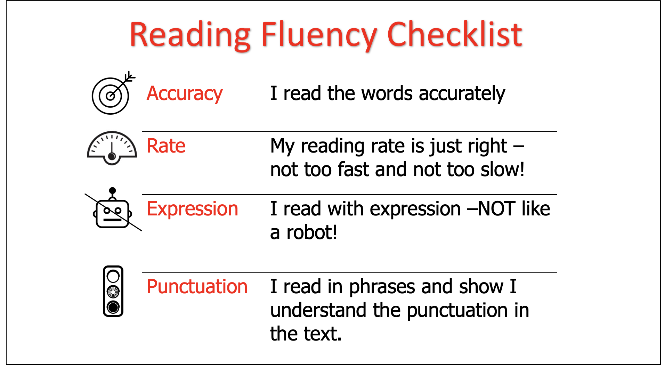
What Does it Look Like?
They read aloud effortlessly and with expression
Their reading sounds natural, as if they are speaking.
When they read silently, they recognise words automatically.
They group words quickly to help them gain meaning from what they read.
They can make connections among the ideas in the text and their background knowledge.
They recognise words and comprehend at the same time.

Slide 4
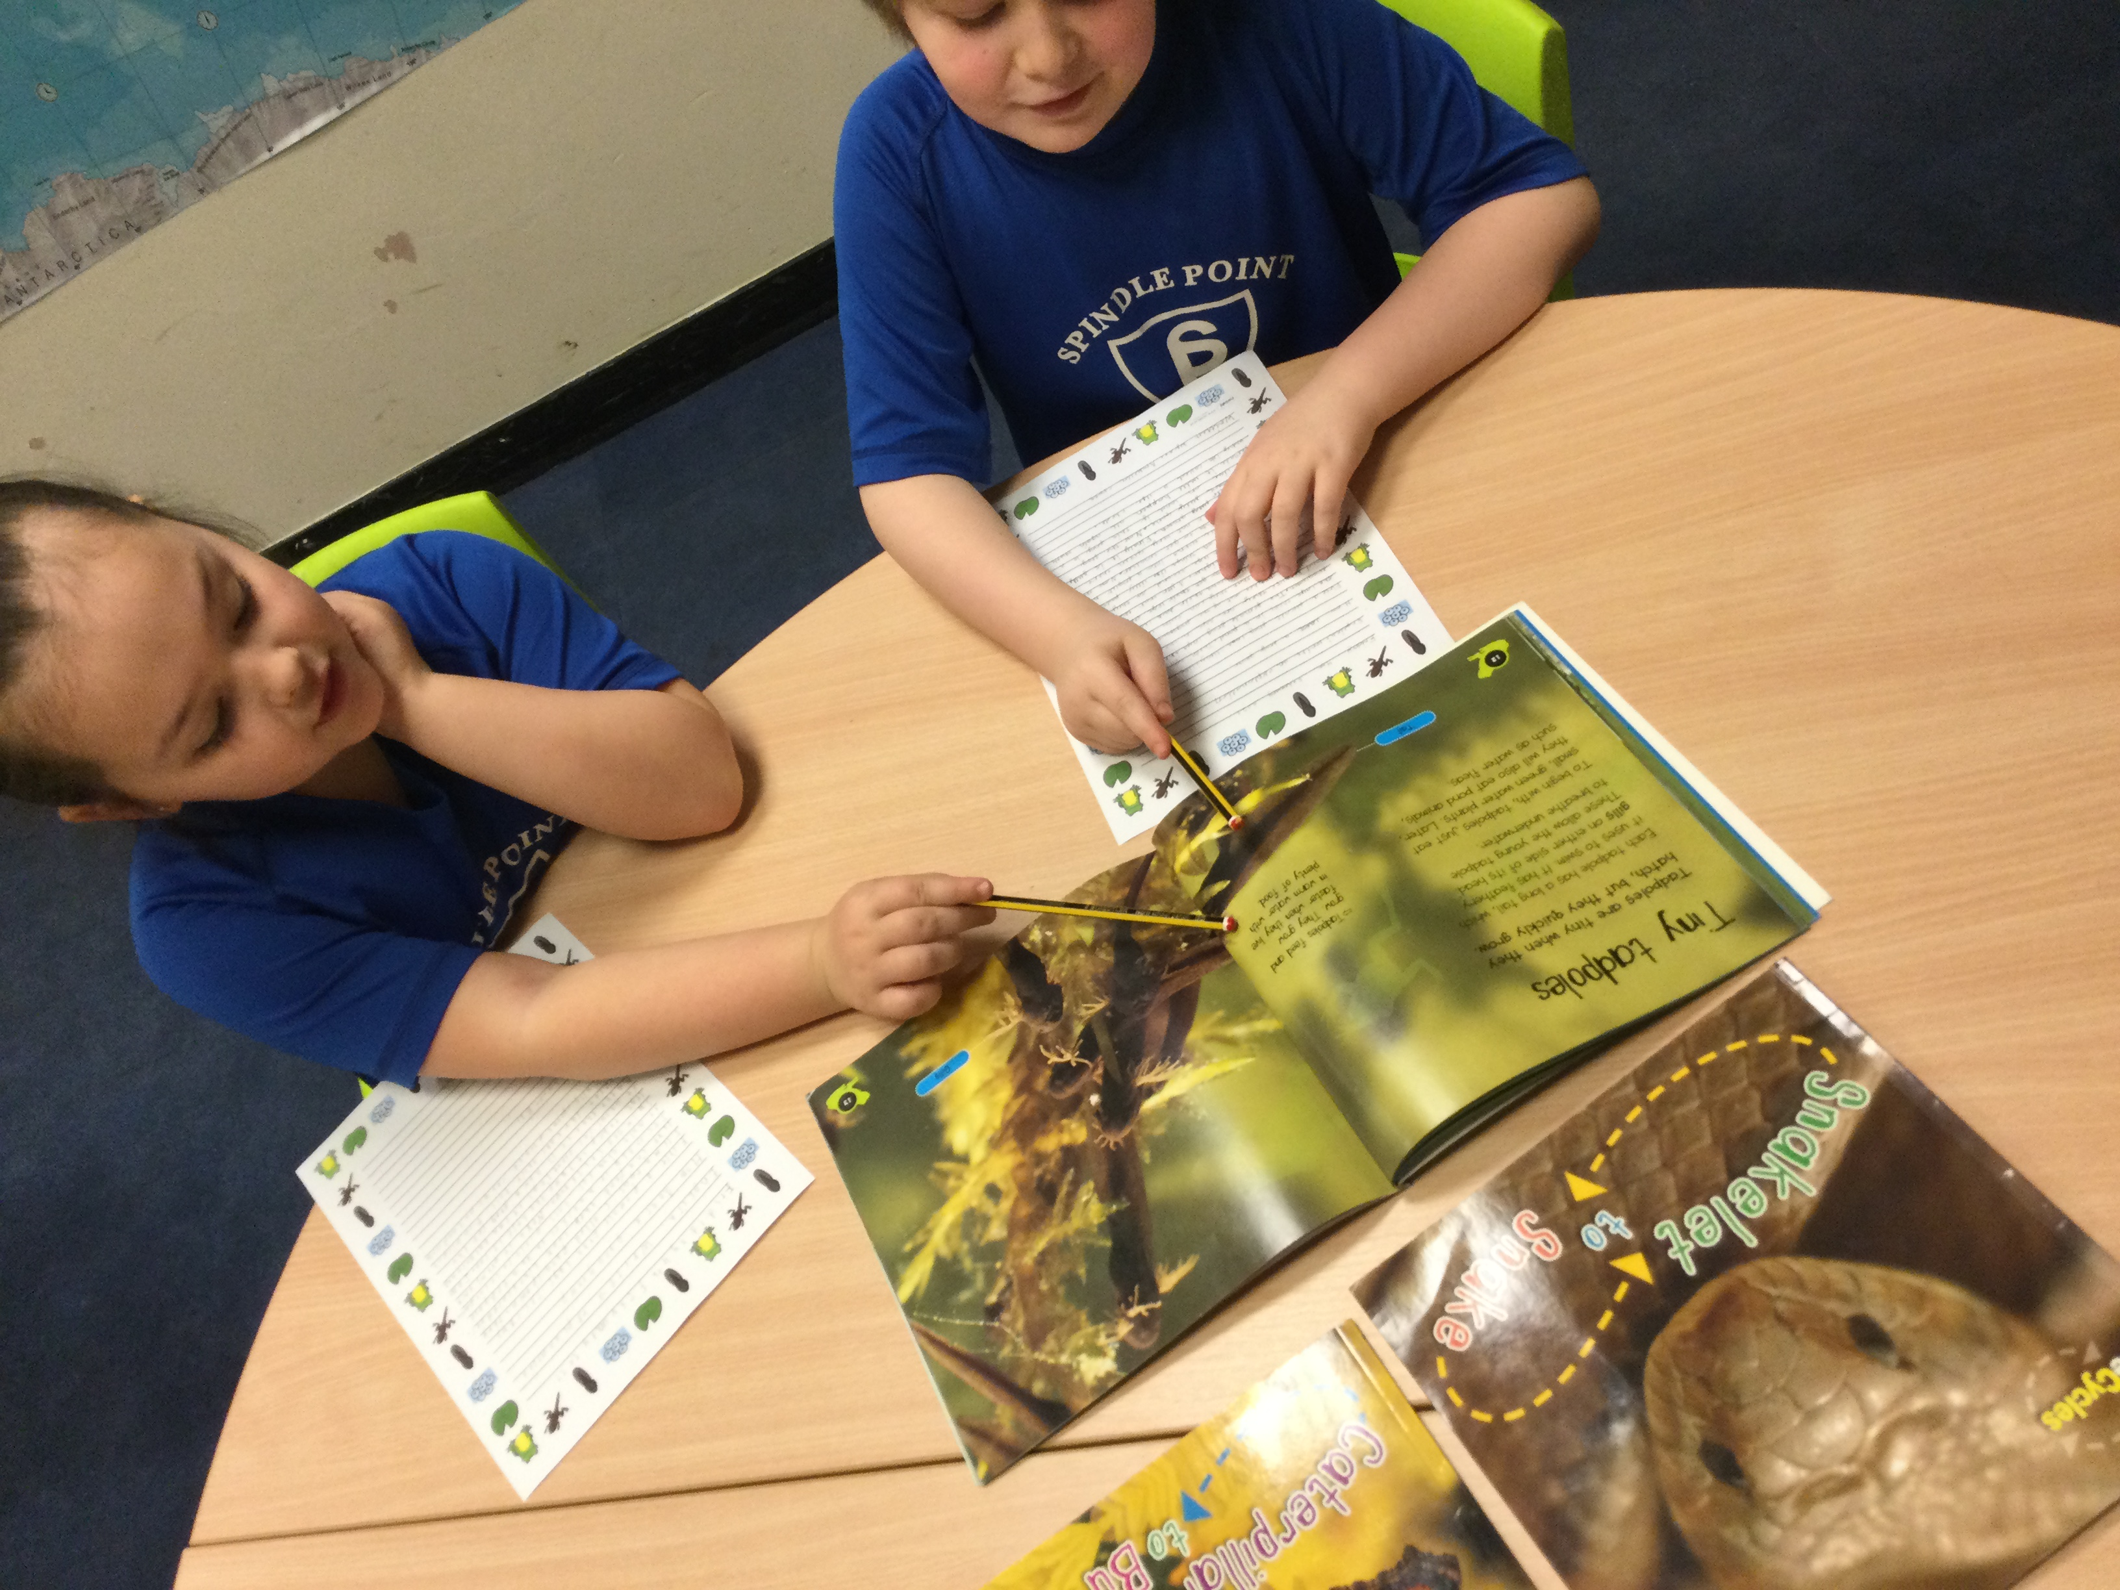
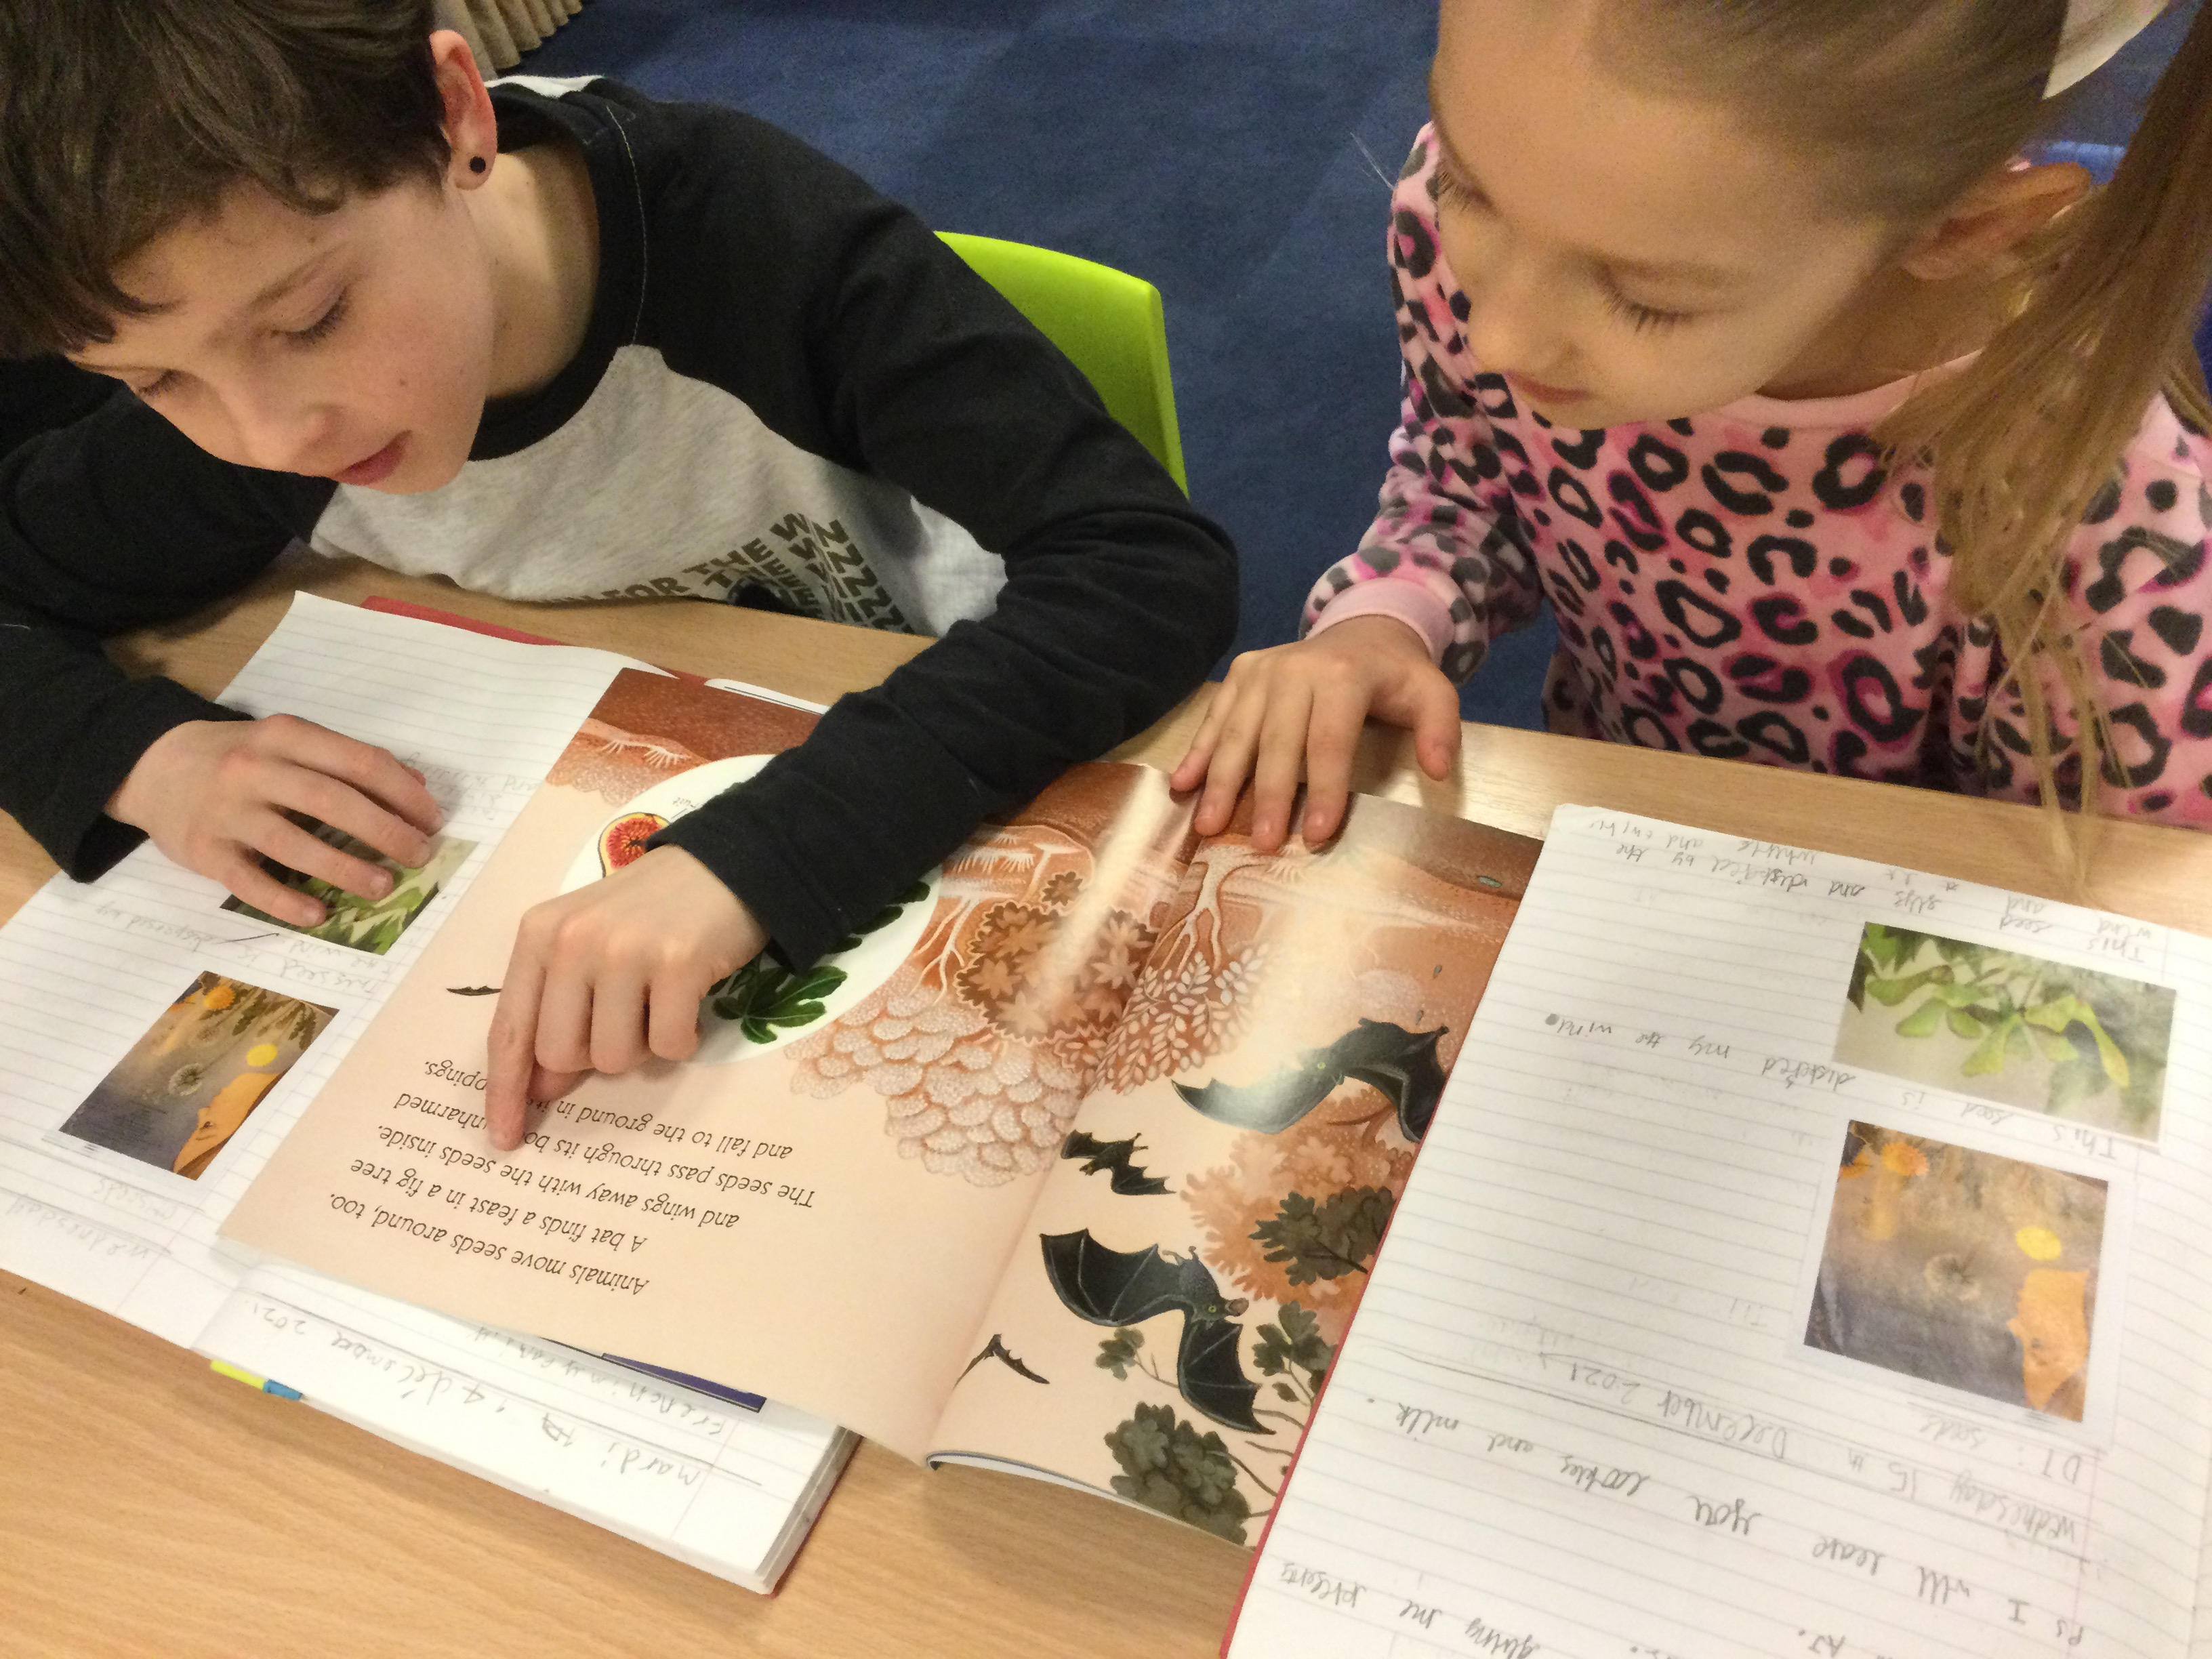
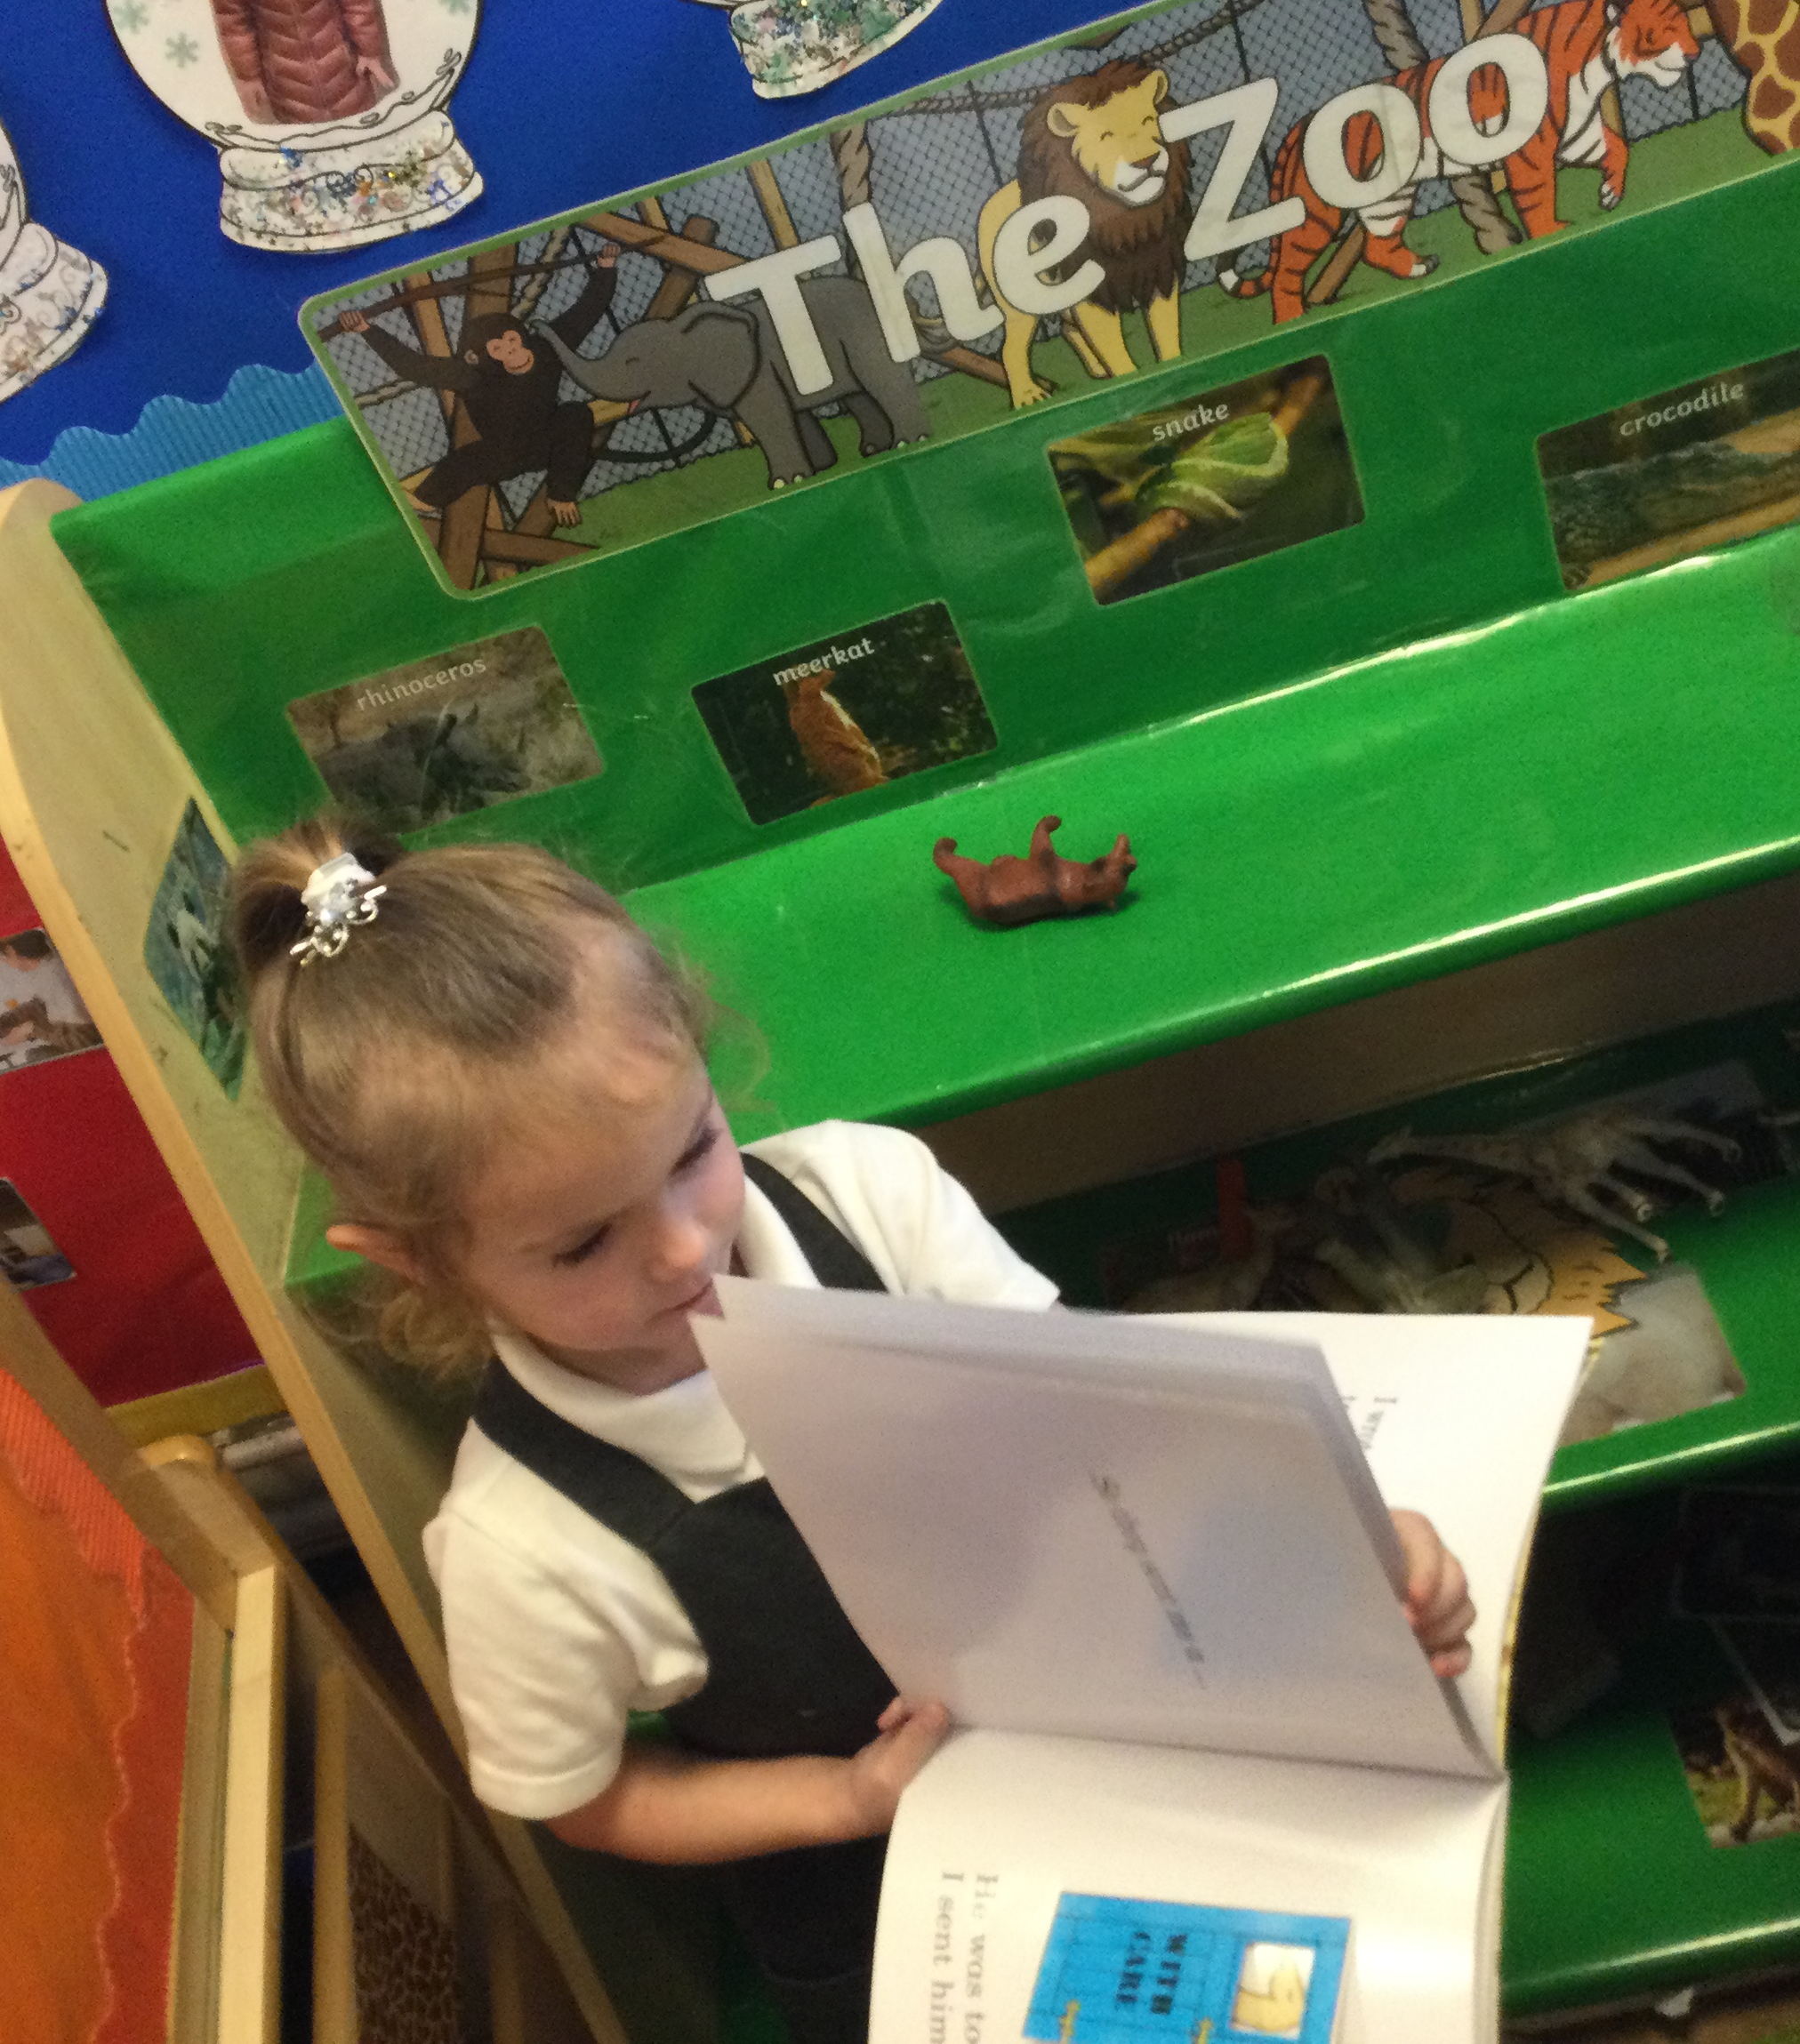
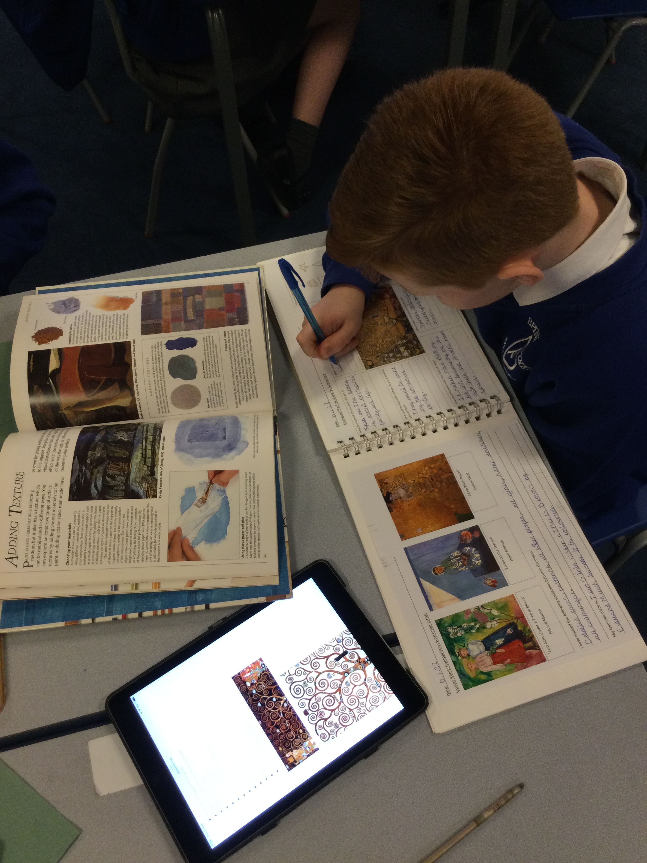

Reading fluency is important for learning in all subjects to understand information. Developing reading fluency enhances a pupil's ability to comprehend the written word, enabling them to use reading as a vehicle to learn.

